Slide 1

Prof. Dr. Samar HassabAllah kassem
Biotechnology Program
Faculty of Applied Health Sciences Technology
October 6 University
Drsamarkassem.ams@o6u.edu.eg
Course Name / Recombinant DNA technology- MBBMBR213

Slide 2
Scores
40: final
20: Practical
20: Mid term
2o: assignment – project - quiz- activities

Slide 3
Definition
Recombinant DNA technology are known as genetic engineering or gene cloning, refers to the process of artificially combining DNA from different sources to create new genetic combinations. This technology has revolutionized biotechnology, medicine, agriculture, and scientific research.

Slide 4
Process of gene cloning
1. Gene Identification and Isolation:
Scientists first identify and isolate the specific gene of interest. This can be a gene coding for a protein, enzyme, hormone, or any other desired trait (e.g., insulin production).
2. Cutting DNA with Restriction Enzymes:
Specialized enzymes known as restriction enzymes are used to cut DNA at specific sequences. These enzymes act like molecular scissors, allowing for precise cuts in the DNA to isolate the gene of interest.
3. Inserting Gene into a Vector:
Once the desired gene is cut out, it is inserted into a vector, which is typically a plasmid (a small, circular piece of DNA found in bacteria). The vector serves as a vehicle to transfer the gene into a host organism.
The enzyme DNA ligase is used to join the DNA fragments together.

Slide 5
Process of gene cloning
4. Introduction into a Host Cell:
The recombinant DNA (vector + gene) is introduced into a host organism, often bacteria or yeast, through a process called transformation. The host organism will take up the recombinant plasmid and incorporate it into its own DNA.
5. Cloning and Expression:
Inside the host, the recombinant DNA is replicated along with the host's DNA as the cell divides. This results in many copies (or clones) of the gene being produced.
If the recombinant DNA contains a gene coding for a protein, the host organism may begin producing the protein. For example, recombinant insulin is produced by bacteria in this way for medical use in treating diabetes.
6. Selection and Screening:
Not all host cells will take up the recombinant DNA, so scientists use selection markers (like antibiotic resistance genes) to identify the cells that have successfully incorporated the new DNA.
Screening methods, such as PCR (Polymerase Chain Reaction) or gel electrophoresis, are used to confirm that the correct gene is present.

Slide 6
Genetic Engineering
The human genome has enough DNA to code for approximately 2X 105 genes of about 15,000 bass pari each.
One of the most controversial issues in nucleic acid research today has been generated by the development of techniques that enable the molecular biologist to insert DNA segments, from any source, into the DNA of bacteria and other cell types including mammalian cells maintained in tissue culture. One example is gene cloning which means isolation of individual genes from the entire genome and its insertion into certain acceptors known as vectors like plasmids.
The DNA product of such manipulation is called recombinant DNA: the technique is popularly known as gene splicing.
As previously mentioned, the insertion of sections of DNA into a DNA molecule became a reality with the discovery and isolation of a group of remarkable bacterial enzymes, known as restriction endonucleases that have the ability to cleave DNA molecules at certain sites with highly specific base sequences.
Such enzymes are synthesized by many microorganisms to digest the DNA of any invading viruses.
When a DNA molecule is cleaved by a restriction enzyme, the cut ends are "Sticky"; and the molecule will recombine, by complementary base pairing, with another DNA segment that has been cleaved by the same enzyme.

Slide 7
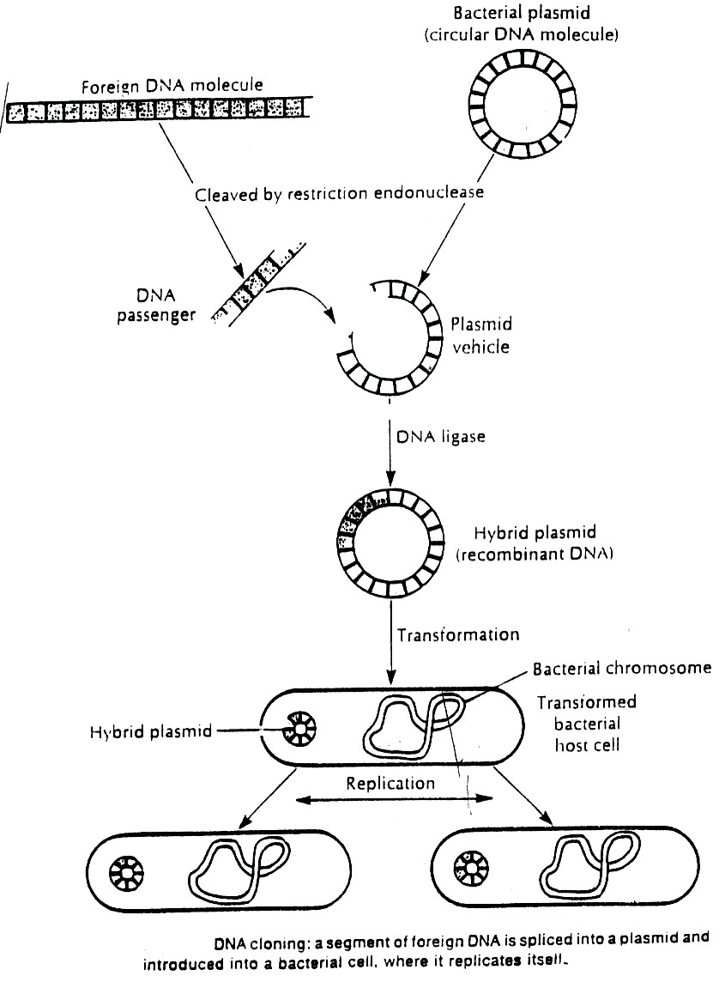
Genetic engineering

Slide 8
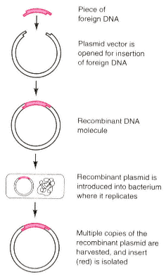

Slide 9
Steps involved in gene cloning
1. Isolation of donor DNA fragment or gene.
2. Selection of suitable vector.
3. Incorporation of donor DNA fragment into the vector.
4. Transformation of recombinant vector into a suitable host cell.
5. Isolation of recombinant host cell.

Slide 10
Applications of Recombinant DNA Technology
:
• Medicine: Producing insulin, human growth hormone, clotting factors, and vaccines.
• Agriculture: Genetically modified crops with enhanced traits such as pest resistance or increased yield.
• Research: Studying gene functions, creating gene therapies, and investigating genetic diseases.

Slide 11
Plasmids
Plasmids are small, circular duplex DNA molecules whose natural function is to confer antibiotic resistance to host cell.
Plasmids replicate independently from the bacterial DNA.
Plasmids are present as single or multiple copies within the bacterium.
The common plasmid vector has both tetracycline and ampicillin resistance genes.

Slide 12
Impact of molecular biology on genetic diseases
Once a gene has been fully characterized, abnormalities leading to diseases associated with it can be identified at the level of both the DNA sequences and the protein which it encodes. This often leads to an improved understanding of the disease process, and can allow detection of the abnormal gene in DNA samples from patients who: (i) have or are susceptible to the disease; (ii) are carriers; and (iii) the unborn fetus.
Genomic Library
When the entire genome of an organism is digested by restriction enzymes and each of the DNA fragments obtained is cloned into a cloning vector, such a set of cloned fragments is known as the genomic library.

Slide 13
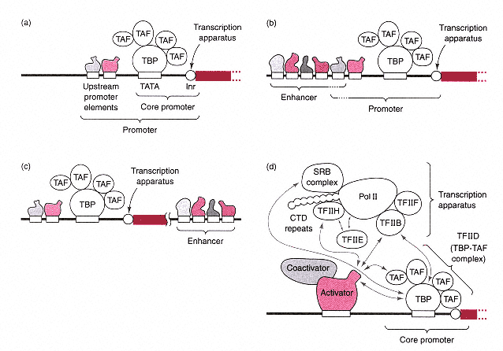

Slide 14
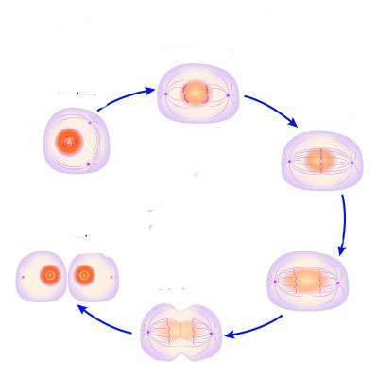
Mitosis

